Slide 1


IPTEK CIC – DIVISI WEB
Getting Started with PHP!
UKM IPTEK CIC – STMIK CIC Cirebon – http://iptekcic.com – iptekcic@gmail.com

Slide 2
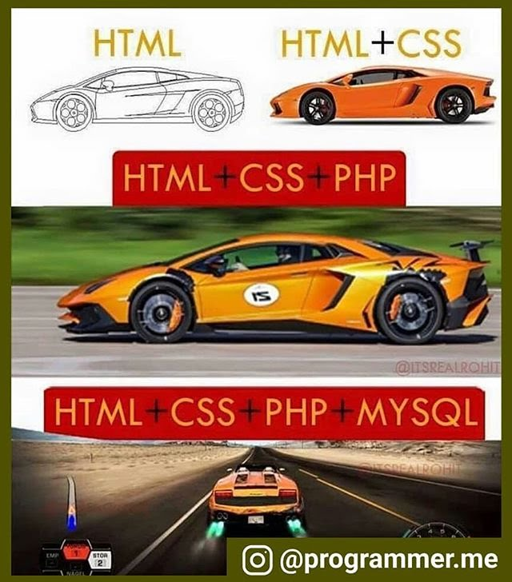
HTML - CSS - PHP
HTML : Bahasa Markah (Kerangka).
CSS : Styling (Gaya, warna, lebar, tinggi, etc)
PHP : Mengerjakan fungsi-fungsi tertentu.

Slide 3

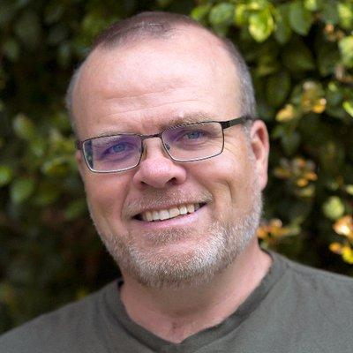
All about PHP
RASMUS LERDROF

Slide 4

All about PHP
https://www.phpindonesia.id

Slide 5
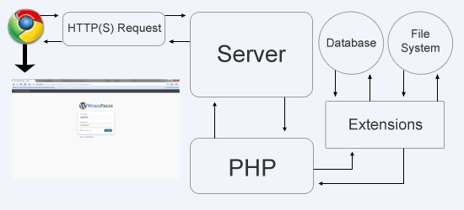
How PHP works ?
http://nepsdotin.github.io/php-tutorial/site/unit-3/how-php-works/

Slide 6



Requirement Tools
Text Editor
Web Browser

Slide 7



Requirement Tools
Database Server
Web Server
Xampp Package

Slide 8

<?php
echo “Let's Coding Now!”
?>

